Slide 1
Linear Algebra
Seriously the best of the Algebras

Slide 2
LAST TIME ON:
THE MATH RANTINGS OF ROB

Slide 3
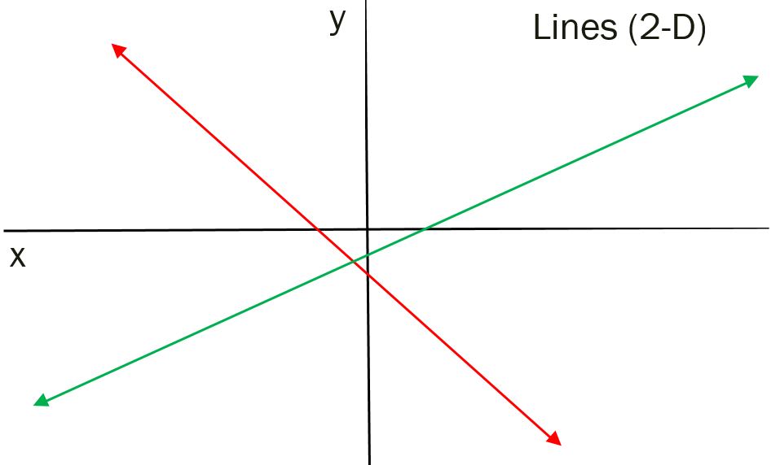
FUNCTIONS AS SETS
eats

Slide 4
THIS IS ONE OF MANY WAYS OF LOOKING AT IT!

Slide 5
So Where’s The Algebra?
Look I’m giving you numbers!

Slide 6
Still NO Algebra?
Recall:
whenever
AND!!!

Slide 7
I’m Starting to get Mad!
We have two approaches

Slide 8
I’m about to gut punch you Rob!
First Approach:

Slide 9
SERIOUSLY!
First Approach:

Slide 10
FINALLY!
First Approach:

Slide 11
Now I remember that I hate Algebra
First Approach:

Slide 12
Will This Problem Never End?
First Approach:

Slide 13
GROUP WORK:
(a)
(b)

Slide 14
GROUP WORK:
(c)
(d)

Slide 15
Algebra has Rules?
Mathematics is a logical system of rules (and we got good at logic)
We just did some procedure using “Algebra” did we see some rules?
Spoiler Alert:
(fancy use of the word equals)

Slide 16
So much Algebra!
Second Approach:
So “equals” says:
IF
THEN

Slide 17
But really hating Algebra right now!
Second Approach:
AND “equals” says:
IF
THEN

Slide 18
This is suppose to make sense?
Second Approach:

Slide 19
Whiskey Tango Foxtrot!
So...
Equals MEANS: “THE SAME!”

Slide 20
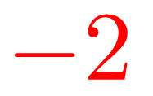
Make Algebra Great Again!
Wha?!

Slide 21
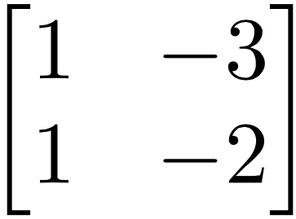
This is Algebra?!
Called a “Matrix”

Slide 22
That don’t make no sense!

Slide 23
Can we put it together?

Slide 24
OUCH...

Slide 25
GROUP WORK: (use a matrix)
(a)
(b)

Slide 26
GROUP WORK: (use a matrix)
(c)
(d)

